Slide 1

CA22123 EU-MACE: Core Group monthly update GP3 #9
Virtual
15/07/2026

Slide 2

Hello!
Today’ meeting is recorded!

Slide 3
0. welcome
Update since last meeting and ongoing actions
Conference grants!
Young EU-MACE
LegacyLabs2 latest developments
ERASMUS+ (and other types of training program) building ➔ October meeting
B2B MAP-list
InterCost-Actions ➔ CSA call
Next GP training school or training module?
Next GP = Last GP ➔ Final Conference
Workshop in October
Next meeting dates
Young EU-MACE webinar GP3 n°5: Sanna Jarl – Uppsala Univ, Sweden

Slide 4
Update since last meeting

Slide 5
Conference & stsm grants open
Conference grants announced on website & LinkedIn with priority conference selection
NuMat2026 (Sept 21-24, Canada) – 1 disseminination CG only
MSE2026 (Sept 29 – Oct 1, Darmstadt) ➔ 3 + 1 YRIG granted
AI4AM (May 19-21, Madrid) ➔ 1 YRIG granted
ECT (Sept 14-18, Edinburg) ➔ 2 submissions only … (1 rejected)
AI4X (15-19 June) – 1 Dissemination CG only ➔ none…
4 more applications under evaluation
27 grants foreseen: 6 only granted, 5 more under evaluation ➔ Going to a conference in August/Sept/Oct? Does your subject touch ‘acceleration’ or ‘accelerated’ methodologies applied to energy materials? ➔ APPLY!
Note: Priority given to active members (and their group members)
STSM grants:
Reserved for LegacyLab2 collaboration building ➔ waiting for the next discussion meeting
Several applications not aligned with Action objectives, or not part of LegacyLab2 (for STSM) have been rejected

Slide 6
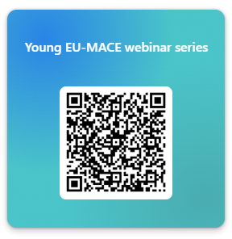
Young EU-MACE seminar
Young EU-MACE (≤ 40 years old) at any stage of your career
You are invited to share your latest research, ongoing challenges, and/or future project ideas to fellow Action members. The webinar provides an opportunity to showcase your lab and its activities and receive feedback from scientists within the field, and foster new collaborations
Today: Sanna Jarl, Uppsala University, Sweden
Upcoming speakers:
September: Basak Turgut, Ege University, Turkey
October: Jyoti Gupta, Jozef Stefan Institute, Slovenia
November: Michael Buchhorn, Juelich, Germany
December: Holger Rohm, KIT, Germany
Want to share your research and expand your collaborations?
2027 slots are opened!!
Young EU-MACE webinar series – Fill in form

Slide 7
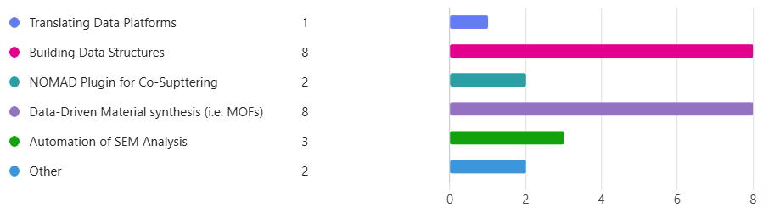
Legacylab 2 update
High temperature materials and thermo-electrics (5)
Next meeting - (22 – 28th July, tbc)
LL2 participants to confirm availability
Activity discussion in LL2
Discuss mini project contents and arrangement
Identify mini project leaders
Confirmed STSM along with MC meeting 19th to 21st October – content tbd

Slide 8
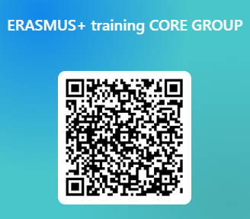
Erasmus+ and other training network building
You can still join (email me if you do): https://forms.office.com/e/2b0DmVgyAV
6th meet July 8th ➔ Planning of October meeting with LegacyLab2
To delve further into training programmeS building (Theo K’s and Viktor K’s propositions
Possibility of Training modules instead of Traning school?
Next meeing = In-person
Combine with LegacyLab2 meeting
At PORT, near Wroclaw, Poland (at Ivy’s) 19-21/10
At NCBJ, near Warswa, Poland (Jarek’s) 5-7/10
3 days
½ day online MC meeting +
ChainMap B2B expert list on-boarding
More information via email and Slack + next monthly update

Slide 9
1. The PRISM Project – Viktor Kislyuk (KNU Ukraine) (Physics and Materials Science Research Integration through Scalable Modules)
Tech Baseline: Moving beyond Moodle to Open edX — the premier enterprise virtual learning framework supported by Microsoft, Harvard, and MIT (infrastructure currently being deployed by KNU) to host virtual labs using real experimental data arrays (CSV/noisy signals).
3-Tier Structure: Tier 1 (Foundation): High schools (via Lyceum); Tier 2 (Core): BSc lab workflows (Spectroscopy/Characterization); Tier 3 (Advanced): MSc/PhD modules bridging frontier physics with academic publishing.
Consortium Status: Lead Coordinator: KNU (Taras Shevchenko National University of Kyiv, Ukraine); Expressed Strong Interest : Univ. of Thessaly, Greece (Prof. T. E. Karakasidis). METU & Turkey (Prof. T. Yalçınkaya). Confirmed: IMP NASU (Kurdyumov Institute for Metal Physics)
In Progress (Ukraine): KAU (Kyiv Academic University) – active partnership.
Option: Capacity Building in Higher Education (CBHE) — Strand 2
Call & Code (Provisional): ERASMUS-EDU-2027-CBHE (Estimated based on current 2026 cycle).
Budget: €400,000 – €800,000 (LS framework).
Mandatory Eligibility Rules: Compliance: Requires ≥2 Ukrainian universities + ≥2 European countries.
Consortium Compliance: 100% Eligible upon concluding KAU talks. Greece (EU Member) + Turkey (Erasmus+ Associated Country) perfectly satisfy the European core; Institute for Metal Physics, National Academy of Sciences of Ukraine joins as a full research partner.
Timeline (Estimated): Call opens late 2026. Submission deadline: February 2027 via EU FTOP.

Slide 10
2. AI4MatEDU-Net (Theodoros Karakasidis U.Thessaly, Greece)
Embedding AI and Data Science into Materials Science Higher Education
THE IDEA
AI4MatEDU-Net equips university educators in materials science, physics, chemistry and related engineering disciplines to integrate AI,
machine learning and automated experimentation into their existing courses.
By training the lecturers/professors/teaching staff (which will act as the multiplier), the project reaches hundreds of students over many years.
WHY NOW
▪ Skills gap: AI and self-driving-lab methods are transforming materials research, but no open higher-education curriculum for educators.
▪ First of its kind: Modules M6-M7 on robotic experimentation and closed-loop autonomous discovery are the first open HE resources in EU.
▪ Built-in network: All 8 partners from EU-MACE COST Action (31 countries) = a ready-made community and shared scientific vision.
WHAT WE WILL DELIVER: 8 INTERDISCIPLINARY TEACHING MODULES (indicative)
* Novel modules + Open Edu. Resources platform, Virtual AI Labs (remote access); 8 stackable micro-cdts (EQF Level 6/7, aligned to DigComp 2.2).
EU PRIORITIES ADDRESSED
Digital transformation, Green transition (sustainable materials & energy), Innovation in teaching, Open science & FAIR data.
FOR DISCUSSION TODAY
▪ Partner commitments: confirm each institution's lead role, work-package ownership and in-kind contribution ➔
▪ Resources: datasets, lab/remote access and student cohorts each partner can pledge for piloting.
▪ Timeline: agree the submission target for the 2027 Round 1 call and the kick-off meeting date.
M1 ML Foundations for Physical Sciences | M2 Neural Networks & Deep Learning
M3 Materials Databases & FAIR Data | M4 AI for Sustainable Materials & Energy
M5 Generative AI & Inverse Design | M6 Automated Experimentation & Robotics *
M7 Closed-Loop Autonomous Discovery * | M8 Capstone: AI Project in Materials Research
Programme: Erasmus+ KA220-HED | Call: 2027 — Round 1
Duration: 36 months | Budget: €400,000 (lump sum)
Coordinator: University of Thessaly | Consortium: 8 partners (EU-MACE network)

Slide 11
3. Hands-on Advanced materials for renewable energy technology –Masters’ program under EIT-InnoEnergy (S. Nakamae, CEA France)
Academic departments: materials engineering, but can be chemistry (electrochemistry) or physics (soft matter, or solid-state) depending on the expertise of the participating researchers/universities
Industrial partners: Building materials, RES technologies
Competence Pillars
Advanced materials: electrochem, transport phenom, characterization tech, heat engines…
Automation and acceleration: Robotics, AI, exp workflow
Device/System design and integration: PV, batteries (elec. Storage/distribution), heat exchangers/thermal storage, hydrogen?
Economics & sustainability: LCA, techno-economics, material circularity
Courses and Projects (require: prototyping lab for modules/devices)
Thermal harvesting, circulation and storage
PV panels with battery modules
Thermal insulation …

Slide 12
Erasmus+ and other training network building
You can still join (email me if you do): https://forms.office.com/e/2b0DmVgyAV
Your name | Your affilliation
Victor Kislyuk | G.V.Kurdyumov Institute for Metal Physics of National Academy of Sciences of Ukraine/ Taras Shevchenko National University of Kyiv
Theodoros Karakasidis | University of Thessaly
Roberto Iglesias | University of Oviedo
António Pereira Gonçalves | Instituto Superior Técnico, Universidade de Lisboa
Suraj Gupta | Jozef Stefan Institute
Tuncay Yalcinkaya | Middle East Technical University
David Lacroix | Université de Lorraine
Theodora Kyratsi | University of Cyprus
Sandra Rabaça | Instituto Superior Tecnico, Universidade de Lisboa
Jafar Iqbal Khan | University of Hull
Awni Hasan Farah Alkhazaleh | Al-Balqa Applied University / Prince Hussein bin Abdullah II Academy of Civil Protection
David Culliton | SETU Carlow
Alberto Otero de la Roza | University of Oviedo
Saco Nakamae | CEA

Slide 13
other Actions
ChainMAP
Expansion to include Research infrastructures and technologies ➔ started May 2026
M. Wolf (AT), B. Postolnyi (PT), M. Fabrizio (IT), D. Koren (BE), S. Nakamae (FR), I. Galanakis (GR), K. Malek (DE)
Will create 3 separate database from ONE unique master-database
Survey Form created (D. Koren & M. Wolf) ➔ under review now ➔ to be distributed to all MC & ‘active’ members
Inter-COST & Action Sustainability: Norbert Babcsan (HR, MC)
Sign up! https://forms.office.com/e/3gArV3xVnC
Join EERA’s AMPEA! (permanent structure for preserving our network) ➔ special session at October meeting
Joint CSA search with COST Action DAEMON ➔ CSA call for 2027 ➔ Questionnaire on ‘patents’
TDM (WG3) white paper: Kourosh M. & Theodoros K.
Draft modification
Introduction (Saco) ➔ working on it!!
Domain experts to receive the draft with instructions before the end of July
Min Ying | Tsang
Davide | Mariotti
Norbert | Babcsan

Slide 14
training school or training modules
Most effective way of imparting useful knowledge ?

Slide 15
‘Traing’ for GP3
ChainMAP
Expansion to include Research infrastructures and technologies ➔ started May 2026
M. Wolf (AT), B. Postolnyi (PT), M. Fabrizio (IT), D. Koren (BE), S. Nakamae (FR), I. Galanakis (GR), K. Malek (DE)
Will create 3 separate database from ONE unique master-database
Survey Form created (D. Koren) & under review (M. Wolf
Inter-COST & Action Sustainability: Norbert Babcsan (HR, MC)
Sign up! https://forms.office.com/e/3gArV3xVnC
Join EERA’s AMPEA! (permanent structure for preserving our network) ➔ special session at October meeting
Joint CSA search with COST Action DAEMON ➔ CSA call for 2027 ➔ Questionnaire on ‘patents’
TDM (WG3) white paper: Kourosh M. & Theodoros K.
Draft modification
Introduction (Saco) ➔ working on it!!
Domain experts to receive the draft with instructions before the end of July
Min Ying | Tsang
Davide | Mariotti
Norbert | Babcsan

Slide 16
Communications

Slide 17
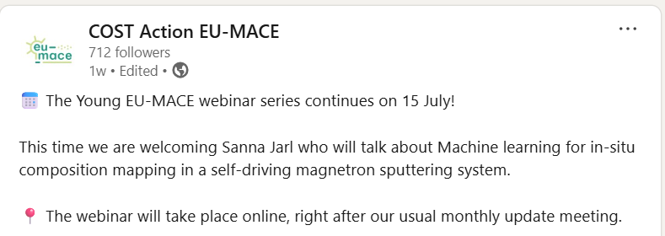

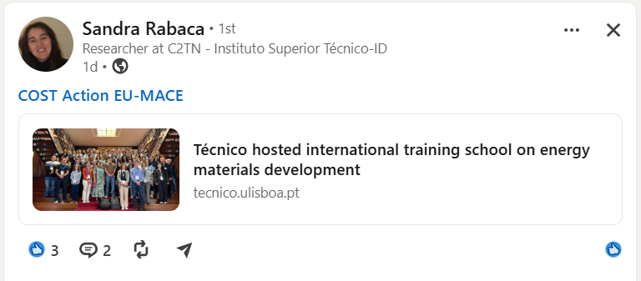
Web & LinkedIn
Monthly update & Slack
Signup sent to new members
LinkedIn followers = 701+11
Action news (meetings, grants, Young EU-MACE webinar announcement)
Member’s news and announcements
Partner project/network news
Vacancy announcements
Website
Contact Dorotea!! D.Koren@eera-set.eu

Slide 18
Next meetings

Slide 19
Next MC/CG monthly update meetings
2nd or 3rd Tuesday of each month @ 3pm
September 8th at 3PM:
ERASMUS progress & LegacyLab2 in-person meeting sessions and other details of October meeting
Progress on other tasks: TDM white paper, ChainMAP ➔ surveys and draft circulation
YEM webinar : Basak Turgut
GP3 Work and Budget plan sneak preview
October MC (hybrid) and WG/Task (in-person) meeting: 19-21/10/2026 at PORT, near Wroclaw or 5-7/102026 at NCBJ, near Warsaw in Poland
➔ dates to be approved
Have a great summer!!!

Slide 20
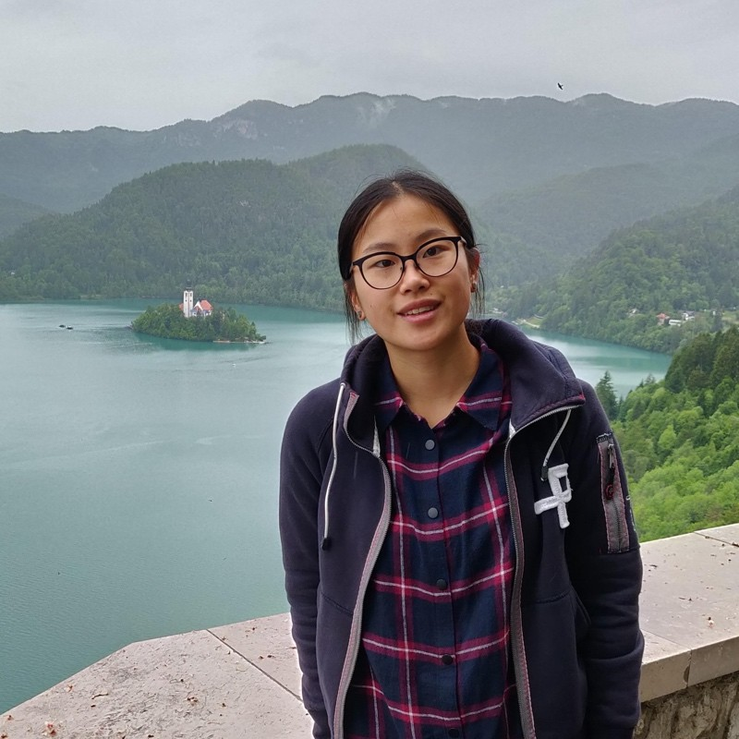

Sanna Jarl – RISE/Uppsala U, Sweden
Machine learning for in-situ composition mapping in a self-driving magnetron sputtering system

